Slide 1
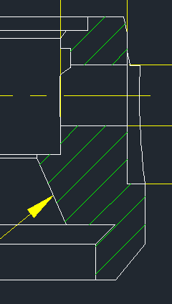
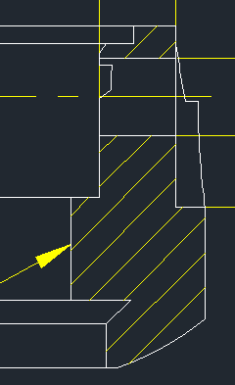
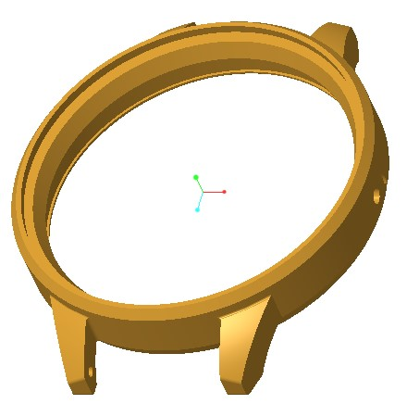
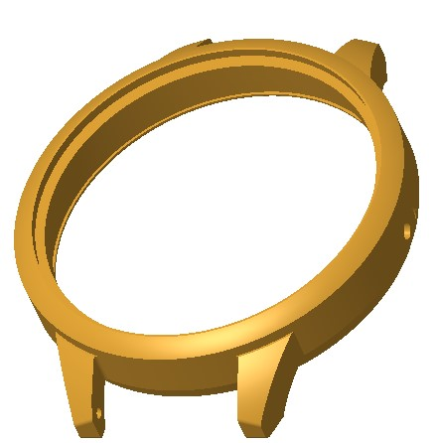
Difference between 2648 and 2617
Model: 2648
Version: XXA
Available versions: A, B, D, E
Identification: Dial opening slant
Model: 2617
Version: XXA
Available versions: A, B, C, D
Identification: Dial opening slant

Slide 2
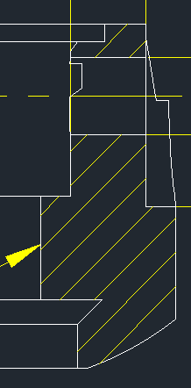
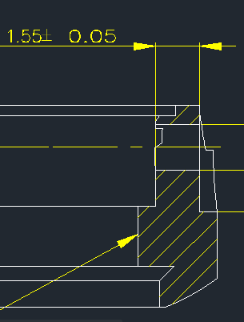
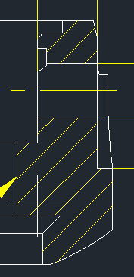
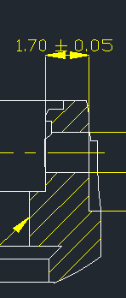
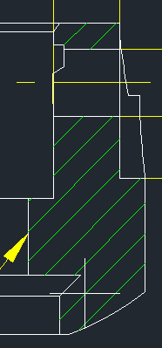
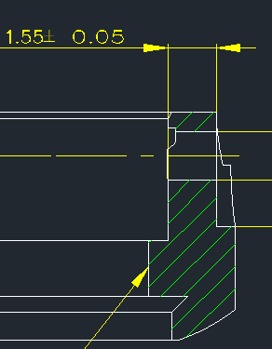
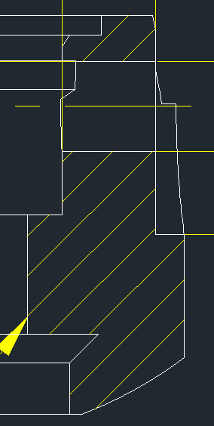
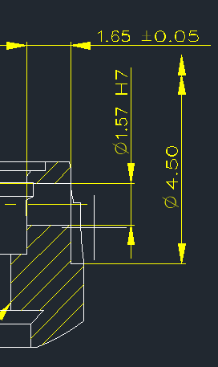
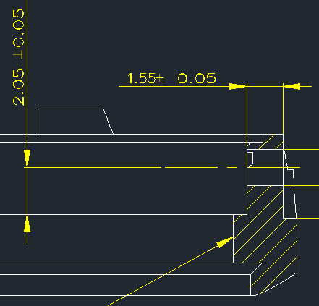
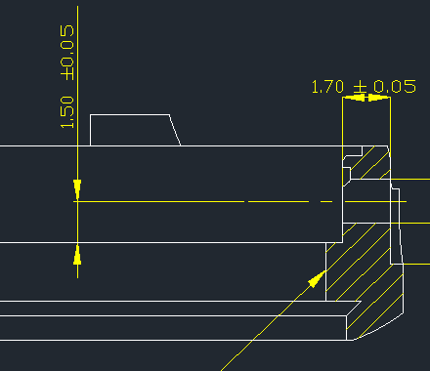
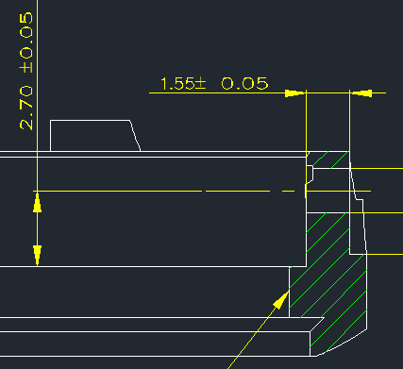
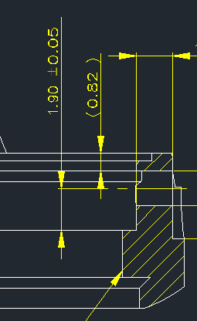
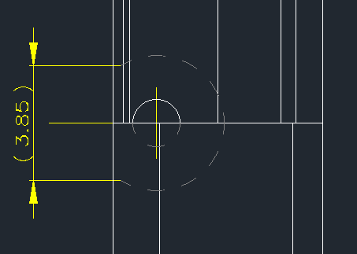
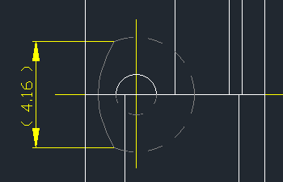
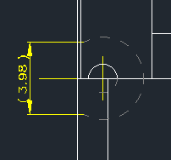
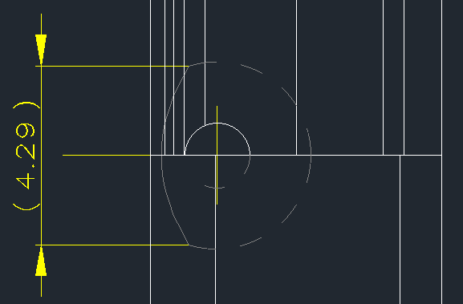
Difference between different variants of 2617
Model: 2617
Version: XXA
Identification: 1)Presence of O Ring Pocket in Case – Yes
2) CPH depth = 1.55
3) CRM length= 3.85
4) CPH centre to dial butting = 2.05
Model: 2617
Version: XXB
Identification: 1)Presence of O Ring Pocket in Case – Yes
2) CPH depth = 1.7
3) CRM length = 4.16
4) CPH centre to dial butting = 1.5
Model: 2617
Version: XXC
Identification: 1)Presence of O Ring Pocket in Case – No
2) CPH depth = 1.55
3) CRM length = 3.98
4) CPH centre to dial butting = 2.7
Model: 2617
Version: XXD
Identification: 1)Presence of O Ring Pocket in Case – Yes
2) CPH depth = 1.65
3) CRM length = 4.29
4) CPH centre to dial butting = 1.9

Slide 3
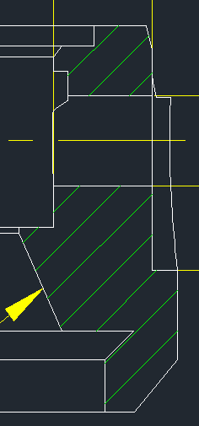
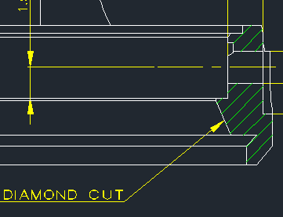
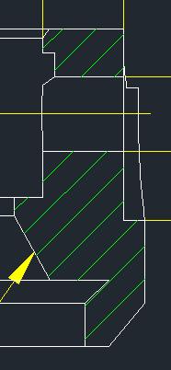
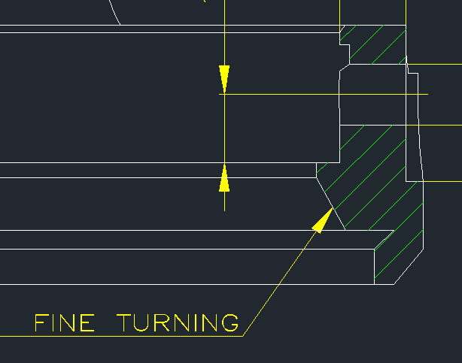
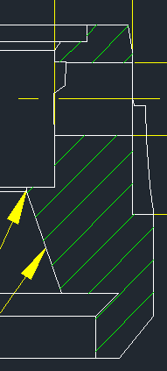
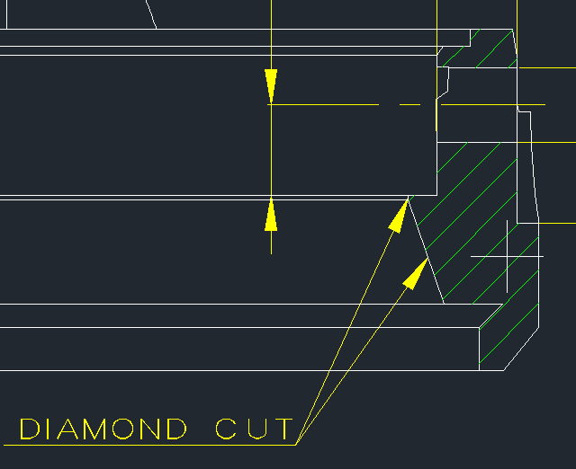
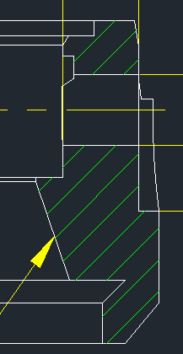
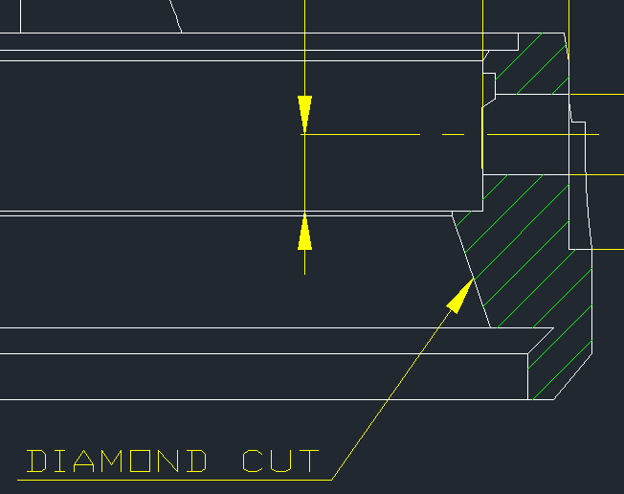
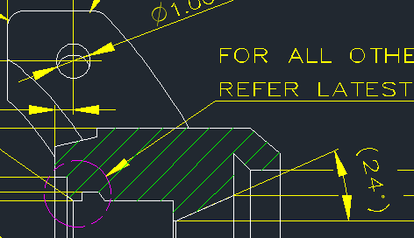
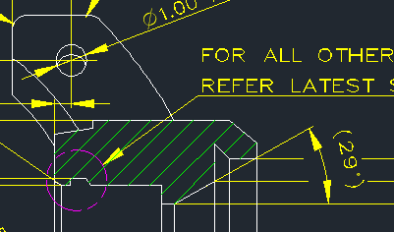
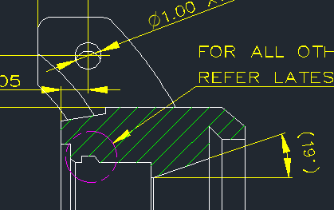
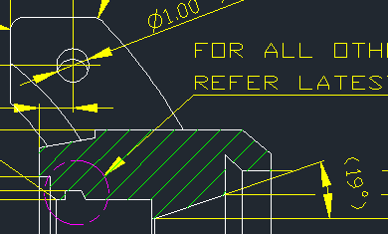
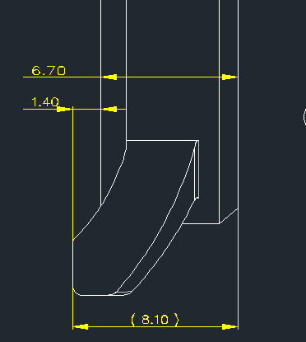
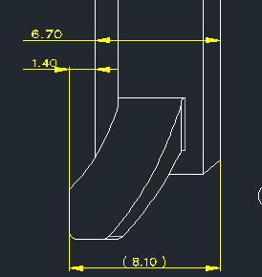
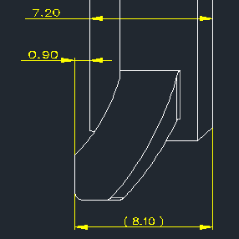
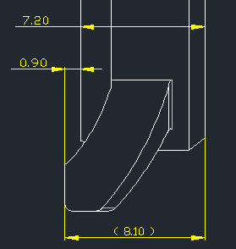
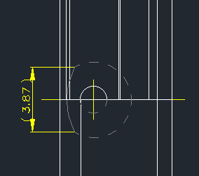
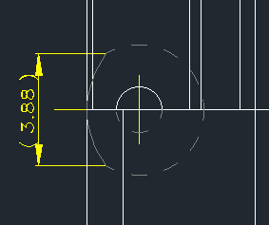
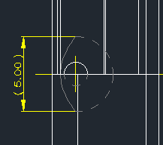
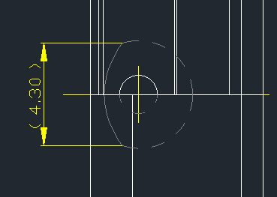
Difference between different variants of 2648
Model: 2648
Version: XXA
Identification: 1)Presence of O Ring Pocket in Case – Yes
2) Dial Slant finish – Diamond cut
3) Thickness = 6.7 and BCB to lug bottom = 1.4
4) Dial slant angle = 24 degree
5) CRM length = 3.87
6) Dial slant height = 1.8
Model: 2648
Version: XXB
Identification: 1)Presence of O Ring Pocket in Case – No
2) Dial Slant finish – Fine turning
3) 6.7 and BCB to lug bottom = 1.4
4) Dial slant angle = 29 degree
5) CRM length = 3.88
6) Dial slant height = 1.75
Model: 2648
Version: XXD
Identification: 1)Presence of O Ring Pocket in Case – Yes
2) Dial Slant finish – Diamond cut
3) Thickness = 7.2 and BCB to lug bottom = 0.9
4) Dial slant angle = 19 degree
5) CRM length = 5.00
6) Dial slant height = 2.3
Model: 2648
Version: XXE
Identification: 1)Presence of O Ring Pocket in Case – Yes
2) Dial Slant finish – Diamond cut
3) Thickness = 7.2 and BCB to lug bottom = 0.9
4) Dial slant angle = 19 degree
5) CRM length = 4.3
6) Dial slant height = 2.3

